Slide 1
City View
Section: D
Name | ID
Md. Tanvir Hossain | 17-33811-1
Dawan Minhajul Islam | 17-33608-1
Mahin Zaman Arnob | 18-37160-1
Abdur Rahman | 17-34794-2
Tazrin Sultana Swarna | 18-37983-2

Slide 2
Introduction & Objective
We have designed a modern city environment. It has the theme of a real city view with busy roads, buildings etc. Our main objective of the project is to capture the theme of a modern city view using modern programming tools and library.

Slide 3
Features & Description
The design will capture the theme of a City. It will be a landscape design with buildings, roads and trees.
There will be moving vehicles on the road.
Moving clouds in the sky.
Plane on the night sky.
The city will be featuring three types of view. One is the day view, one is the evening view and the other is night view.
The roads and environment of the city will be not very busy rather the view will be peaceful with calm and pleasing background music.

Slide 4
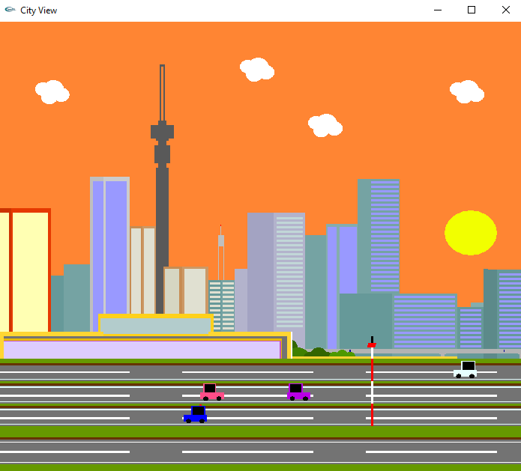
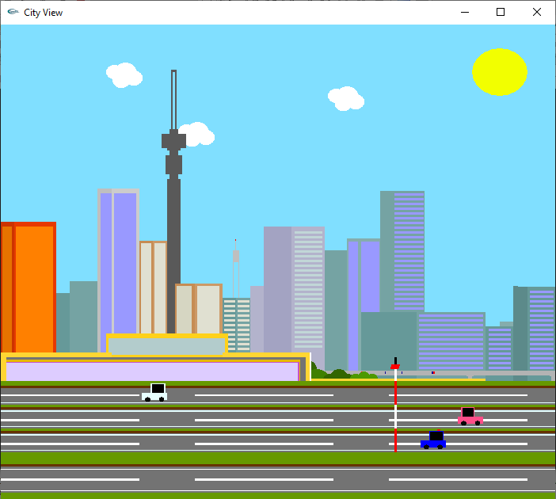
Screenshots of the Project
Day View
Evening View

Slide 5
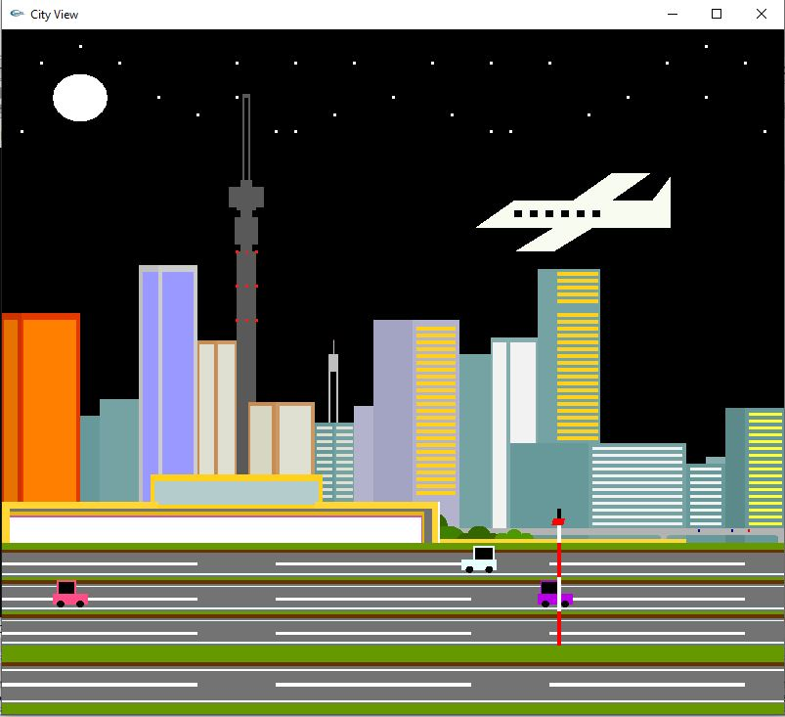
Screenshots of the Project
Night View

